Slide 1
UGP-II: EE392A
Using a restless bandit game to investigate how schizotypy
affects decision-making in dynamically changing environments
Presented by -
Sanika Sanjeev Gumaste
200865

Slide 2
Table of contents
01
02
03
Motivation
Introduction
Methods
04
05
06
Results
Summary
References

Slide 3
01
Motivation

Slide 4
Why did I choose this project?
I approached Dr. Arjun Ramakrishnan for a SURGE project about a year ago, in summer 2022. I was new to the concept of Cognitive Sciences and Decision Making, but I had heard very good things about the lab culture, and the professor.
Additionally, I had done some background reading on Neuroscience earlier, and was excited to get to know more about it.
This project was initiated in the last summer break, where most of my time was utilised in understanding concepts of cognitive science, neuroscience, R language and data analytics. I also learned about the restless four-arm bandit game and associated types of games in Cognitive Science Research.
The UGP - EE392A, gave me an opportunity to dive back in the project and get to learn more.

Slide 5
02
Introduction

Slide 6
Introduction
Studying the mechanism for belief updating can provide useful insights into mental disorders and help develop better diagnosis practices. In this project, we will be using a computer-based restless four-arm bandit game to assess the decisions made by healthy young adults. It would require participants to update their beliefs during the gameplay to make optimal decisions rapidly.
We will analyze these changes in decisions using computational models. We will also ask the participants to fill out surveys to determine their schizotypy scores. Later, we will compare the restless bandit scores with the pre-filled survey results.
This can help us to account for how likely a person is to develop a mental condition like schizotypy in its earlier stages and how that reflects on the behavioral account during the decision made while playing the game. This can help us detect the onset of schizophrenia in healthy young adults.

Slide 7
03
Methods

Slide 8
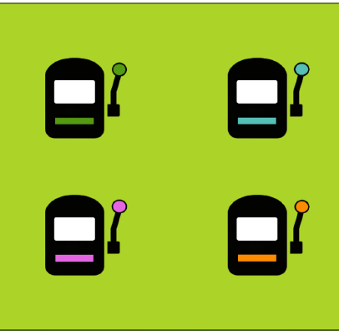
Methods
The restless four-arm bandit game is a game in which a person must choose between multiple options, each with an unknown reward.
The goal is to determine the best or most profitable outcome through a series of choices.

Slide 9
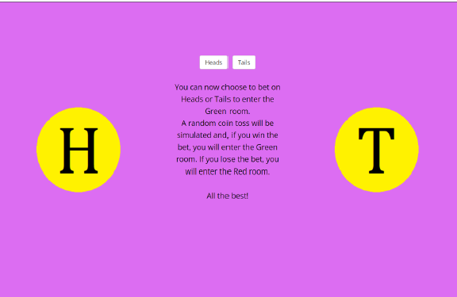
Methods
In our game, we will be using 4 sets of games of 50 moves each. The 4 types of sets vary in block and volatility. The block indicates whether the set in question is a loss or no loss block. It is decided on the basis of a coin flip.
The loss block has negative rewards, whereas the no loss block always has positive rewards.
The volatility indicates how much the rewards change after every decision. We deal with two types of volatility - high and low

Slide 10
Methods
Generalised Linear Mixed Models: GLMMs are an extension of the generalised linear models. To implement GLMMs, we take into consideration sets of models, and not a single model at the same time.
One set of models consists of about 8 models. We can compare the best outcomes of these models and compare them across sets.
We use AIC and BIC scores to analyse the outputs of the GLMMs. Lower the scores, better the model.
PFA the tutorial used for GLMMs in the References section.

Slide 11
Methods
Schizotypy: Schizotypy is a theoretical concept that posits a continuum of personality characteristics and experiences, ranging from normal dissociative, imaginative states to extreme states of mind related to psychosis, especially schizophrenia.
Schizophrenia is a serious mental disorder in which people interpret reality abnormally. It may result in some combination of hallucinations, delusions, and extremely disordered thinking and behavior that impairs daily functioning and can be disabling.
There are three types of symptoms related to schizophrenia - 1. Positive symptoms - Hallucinations, delusions, and disorganized speech and thoughts 2. Negative symptoms - Apathy and withdrawal 3. Cognitive symptoms - Memory issues, inability to decide and process social cues

Slide 12
04
Results
https://drive.google.com/drive/folders/1OpOS-5FZDj6XRF-AOlD07a-sPpBK4CoM?usp=sharing

Slide 13
Results
01
02
03
Level 1
Level 2
Level 3
Running various combinations of models
Refining the models to get the best set of models
Analysing the best models with Schizotypy

Slide 14
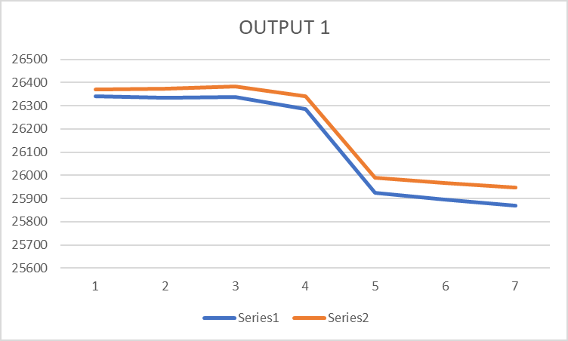
Results - Level 1
Best model from this set: lmer.7 <- lmer(advantageous ~ stable + stress + stress:stable + scale(max1) + scale(diff3) + scale(diff2) +scale(diff1) +(1|run_id), data=df, REML=FALSE)
Analysis: Using stress, scale(max1) and scale(diff3) in the model decreases the AIC and BIC scores
The key variable that causes a significant increase in efficiency is scale(diff3)

Slide 15
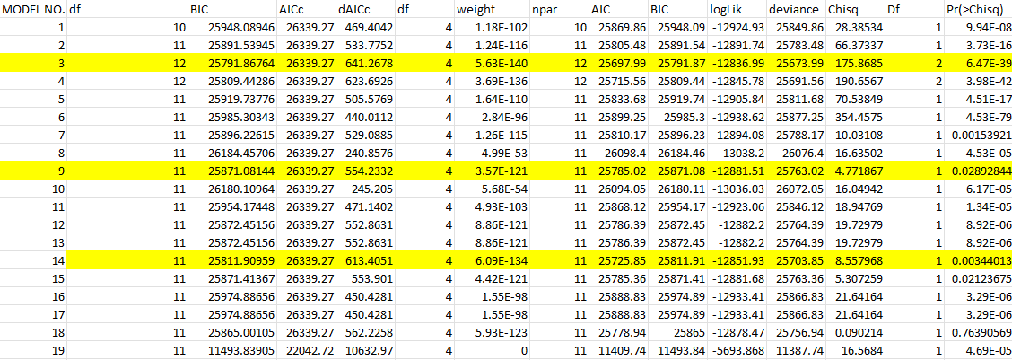
Results - Level 2

Slide 16
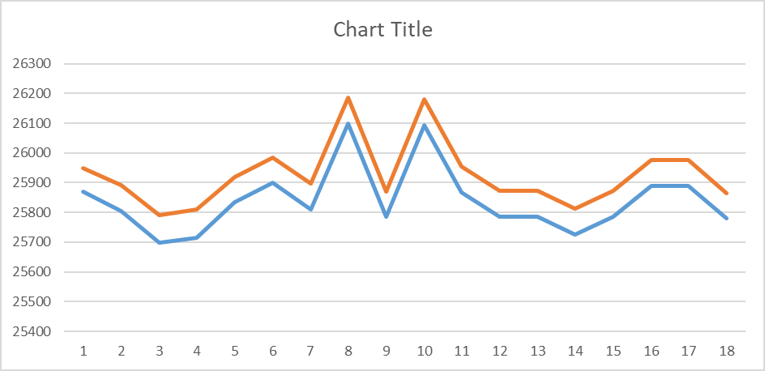
Results - Level 2
Comparing 19 sets of models (19*8 models in total), we finally get a set of 19 best models.
Comparing the best from every set, we get the chart shown here. We consider the three local minima as the three best models for further analysis.

Slide 17
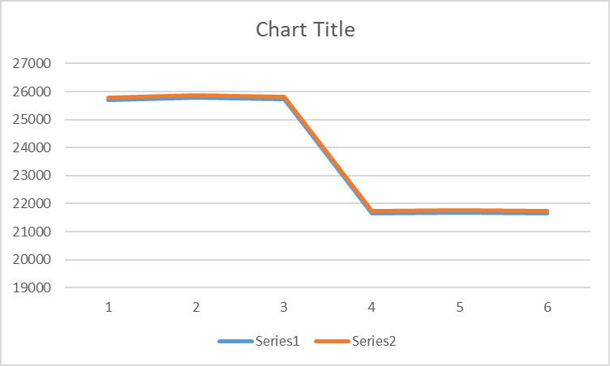
Results - Level 3
The first three models use stress as the primary variable, whereas the next three models use schiz_score as the primary variable.
As we can see, schizotypy has a higher impact on the GLMMs. To get more such conclusions, we need to run more models to compare the effect of adding schizotypy scores in the model.

Slide 18
05
Summary

Slide 19
Summary
Belief updating can be an essential biological marker in tracking mental health illnesses. To assess this, we have used a restless four-arm bandit game with corresponding schizotypy survey results.
The four-arm game consists of four slot machines with varying rewards the participant can choose between to maximize the rewards. The game helps us determine the belief updating of the participants using analytical parameters such as advantageous choices and switching options.
To analyse the correlation, we use variables such as the maximum and minimum rewards, the difference between any two rewards, etc.

Slide 20
Summary
The desirable conclusion from this experiment can be presented by evaluating every one of the four sets of 50 choices each in which the participant plays the game.
Extreme switching could indicate uncertainty and instability of the participant’s decision-making, whereas minimal switching could indicate subpar belief updating in the participants. The choosing of advantageous choices can be analyzed on the basis of volatility and block. It could be a negative indicator if the person plays un-cautiously in negative blocks.
Similarly, minimal risks taken in the positive block could be problematic too. The highly volatile and negative block expects the participant to experience higher levels of stress than usual. Whereas the other two expect a lower stress level.

Slide 21
Summary
Any result/collection of results that deviate from these predictions could indicate some symptom or indicator of schizotypy.
Looking at the variables - diff3, diff4, and max1, along with stable, and schiz_score significantly affect the efficiency of the model. i.e. whether the participant has made the most advantageous choice depends highly on the maximum value of the slot machines and the difference between the values of the slot machines. Variables stress:stable and scale(avg) seem to be the least significant variables in the model.

Slide 22
06
References

Slide 23
References
https://bodo-winter.net/tutorial/bw_LME_tutorial1.pdf
https://bodo-winter.net/tutorial/bw_LME_tutorial2.pdf
Uncertainty and exploration in a restless bandit problem
A Primer on Foraging and the Explore/Exploit Trade-Off for Psychiatry Research
The misestimation of uncertainty
Decision-Making under Stress in Volatile Environments
Champman’s magical ideation
Understanding Learning Through Uncertainty and Bias
Short Scales for measuring schizotypy

Slide 24
07
Acknowledgements

Slide 25
Acknowledgements
I would like to sincerely extend my acknowledgements to the Indian Institute of Technology, Kanpur, for providing me with this opportunity.
I gratefully thank Dr. Arjun Ramakrishnan for this project, and for teaching me many valuable lessons along with the project. I thank him for his patience and his faith in me.
I thank my mentor, Harsh Arora, for believing in me and helping me throughout the project. I thank him for having taught me the nuances of the code and the concept of schizotypy.
I also thank Yatin Azad, for his mentorship in the project and his help.
Lastly, I thank Akhilesh, Kshitij, Chetan, Rakshita, and everyone else who spared their valuable time to teach me important lessons. I would also like to thank everyone in the BSBE Lab 19. It has truly been one of the most enriching and happiest experiences of my life to work in Arjun sir’s lab.

Slide 26
Thank You!

